Slide 1
Preparing the Underprepared for Academic Success:
St. Petersburg College’s Approach to Implementing SB1720
A Conversation with the Jobs for the Future Team
May 26, 2015

Slide 2
Framework for our Conversation
Developmental Education before SB1720
SPC’s SB1720 Implementation
Results
Our findings and upcoming policy changes

Slide 3
Developmental Education Success Rates
Traditional Developmental Education Delivery
Course | Fall 2010 | Fall 2011 | Fall 2012 | Fall 2013
ENC 0020/25 | 59.7% | 57.1% | 56% | 67.6%
MAT 0024/28 | 48.4% | 50.9% | 57.4% | 56.3%
REA 0007/17 | 66.6% | 68.2% | 65.2% | 75%
Redesigned Developmental Education Delivery
Course | Fall 2010 | Fall 2011 | Fall 2012 | Fall 2013
ENC 0056 | NA | 68% | 67.5% | 79%
MAT 0056 | NA | 54.2% | 60.3% | 69.2%
REA 0056 | NA | 86.8% | 78.7% | 88.2%
Source: Pulse, Business Intelligence, Student Success Rates report

Slide 4

College Experience
College Experience
New Student Orientation
Early Alert System
Career Advising
Learning Support
My Learning Plan
Notes:
The College Experience is a values-based, student completion and success initiative composed of five strategic project initiatives.
College Experience Website: http://www.spcollege.edu/5180/

Slide 5
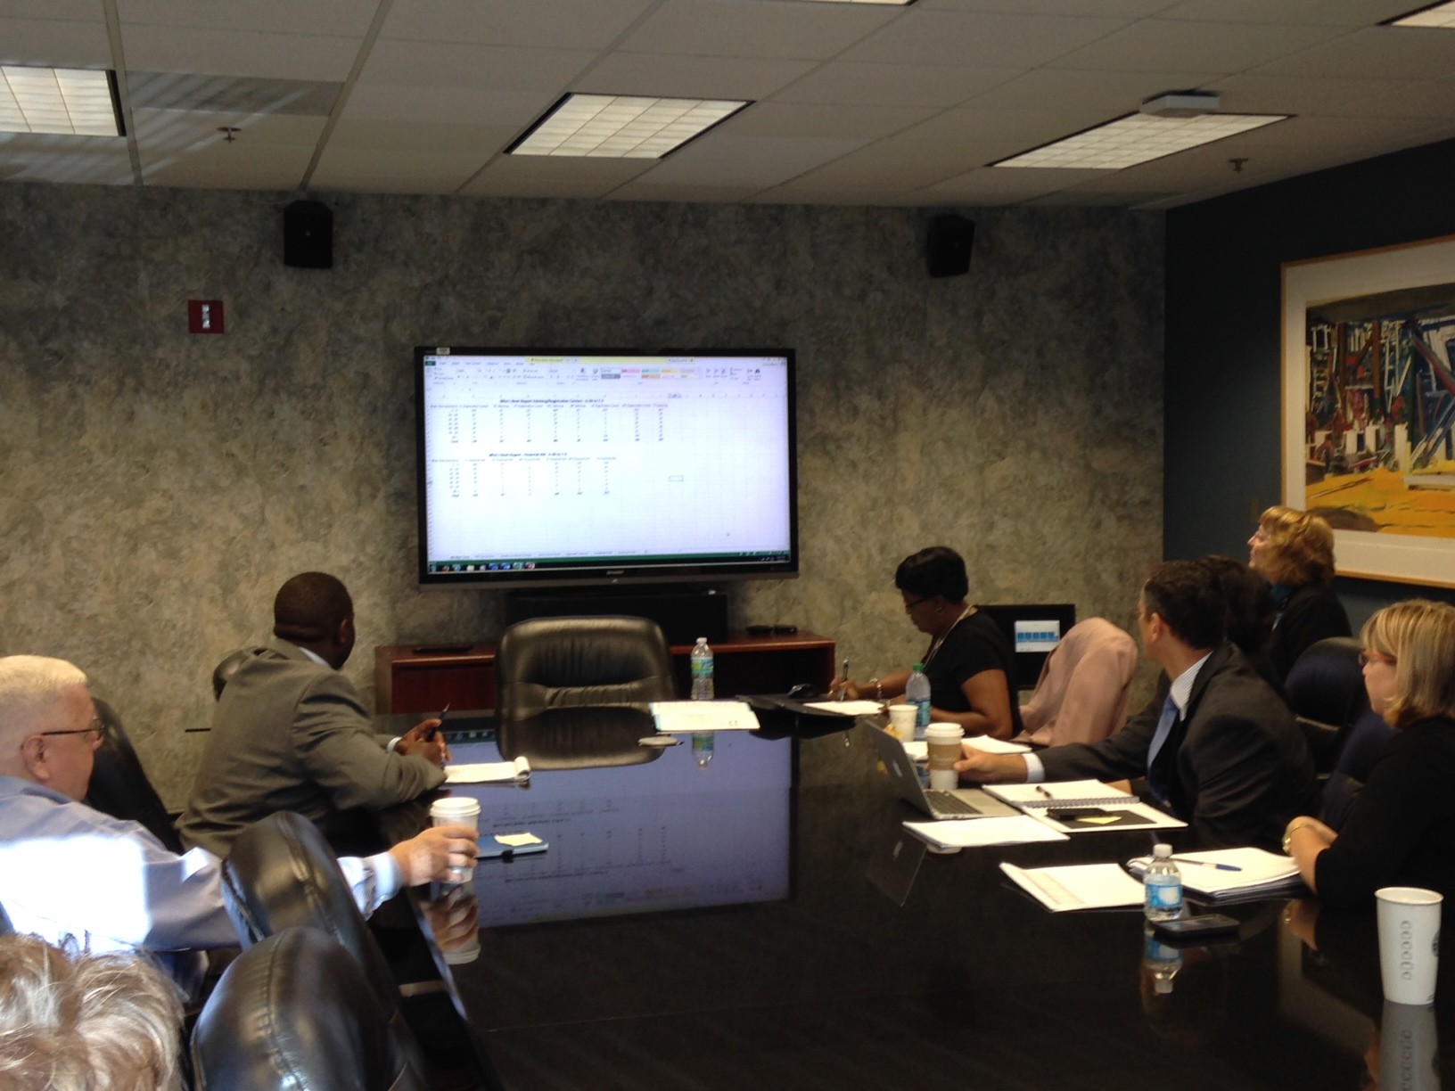
Weekly Webinar
New Student Orientation
Integrated Advising and Career Services
My Learning Plan and Automated Graduation Status
Early Alert and Student Coaching System
Out of Classroom Support
Student Intervention Strategies
Training
Conducted online for staff Every Wednesday morning from 8:30 AM – 9:00 AM
http://www.spcollege.edu/collegeexperience/#tab=3

Slide 6
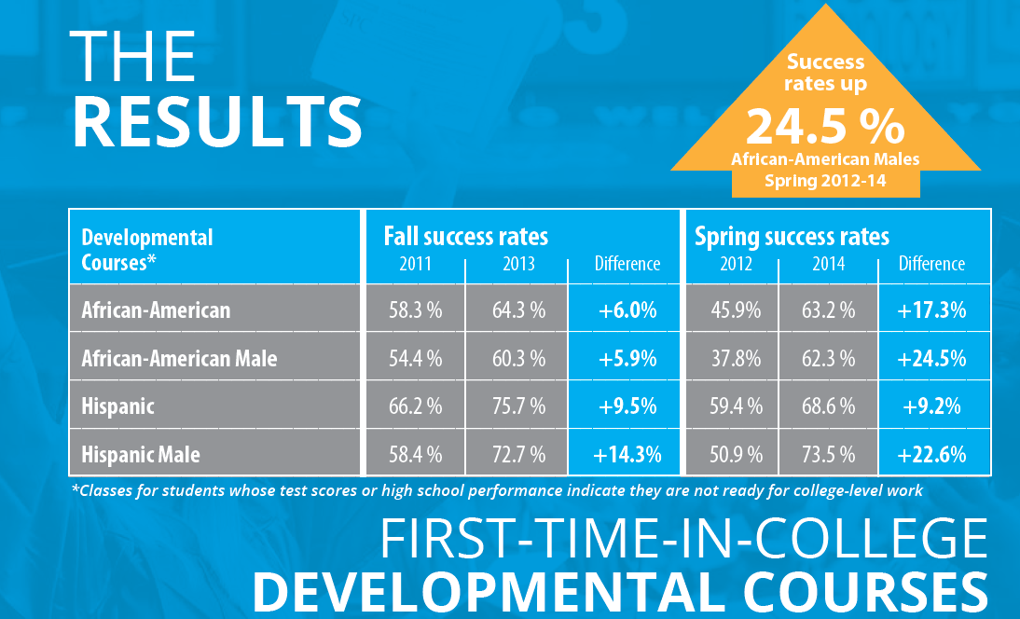
College Experience Results
*Success= Grades A, B or C.
Source: Pulse BI System, data extracted June 16, 2014

Slide 7
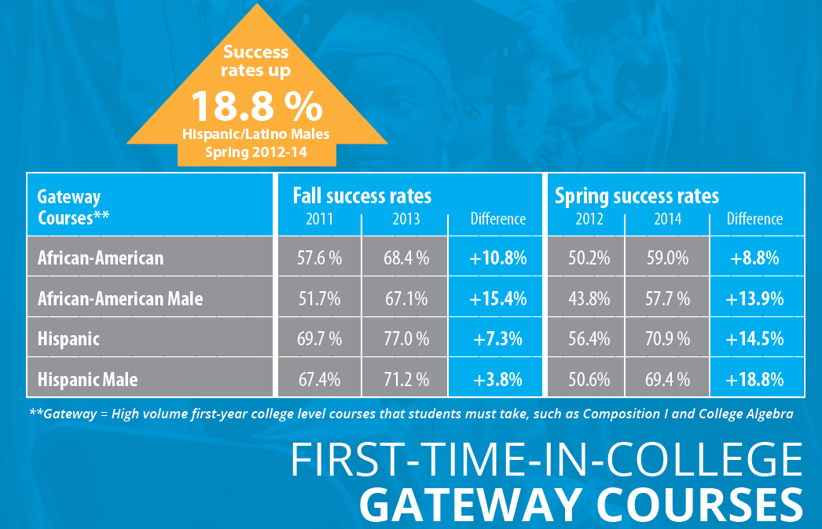
College Experience Results
*Success= Grades A, B or C.
Source: Pulse BI System, data extracted June 16, 2014

Slide 8
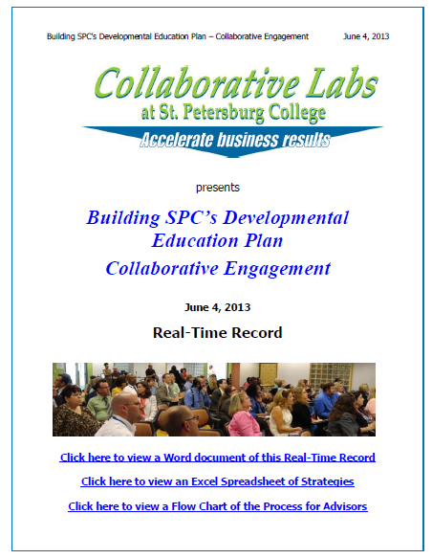
SB1720 Implementation
Leadership support
Oversight group
Dev Ed Committee
Front-line Engagement
Regular BOT updates
Terminology
Technology Enhancements
Early Implementation
Monitoring

Slide 9
Placement Tracks
Using high school/military records, students are grouped into one of two placement tracks. Tools were developed to assist academic advisors throughout the advising process.
Flexible Placement
Traditional Placement
Applicable for students who are no longer required to take the placement test and qualify to enroll directly in college-level coursework based on their high school/military records.
Applicable for all remaining students
Requires valid test scores or completed coursework

Slide 10
Traditional Placement Tracks
Advisors will provide students with options of accelerated pathways to college level courses
    MOOCs
    New developmental education options
    Co-requisite support courses
Students who test into 1 or more developmental education courses are required enroll in the College Success Course and Mentoring course

Slide 11
Flexible Placement Tracks
Advisors will use data to recommend coursework
    Completed college courses
    Test scores (SAT/ACT/FCAT/PERT)
    High school courses/GPA
If an electronic high school transcript is not available, staff can manually enter data using a program calculator to assist with recommendations for placement

Slide 12
Flexible Placement Advising
Advising is REQUIRED for all Flexible Placement students
Advisors review information, make recommendations, and provide options for each subject. The advisor may encourage the student to:
    Review sample college level questions
    Complete online pre-assessment
    Utilize the MOOC (Massive Open Online Course)
    Take the PERT
  Students confirm placement decisions using MySPC, the online student portal

Slide 13
Prediction Rubric for Writing
College Readiness Area | Order of Comparisons | Type of Criteria | Criteria | 3-Likely College Ready | 2-Dev Ed Recommended | 1-Dev ED Strongly Recommended
Writing | 1 | Course Completion | ENC 0025 ENC 0990 ENC 0055/0056 | Grade of A,B, or C |  | All Remaining Students
 | 1 | Course Completion | ENG 0015 |  | Grade of A,B, or C
 | 2 | Assessments within last 3 years | ACCUPLACER-Sentence Skills subtest (200) | 83 or Higher | 58 to 82
 | 2 | Assessments within last 3 years | PERT –Writing subtest (111) | 103 or higher | 90 to 102
 | 2 | Assessments within last 3 years | SAT Reasoning Test Critical Reading subtest (55) | 440 or higher
 | 2 | Assessments within last 3 years | ACT Test-English subtest (177) | 17 or higher

Slide 14
College Readiness Area | Order of Comparisons | Type of Criteria | Criteria | 3-Likely College Ready | 2-Dev Ed Recommended | 1-Dev ED Strongly Recommended
Writing | 2 | Assessments within last 3 years | FCAT Reading 2.0 | 262 or higher | 250 to 261 | All Remaining Students
 | 3 | Course Completion | FL COLL PREP HS Course | Grade of A or B | Grade of C
 | 3 | Course Completion | AP or IB English Course | 1 or more units earned with A,B,or C
 | 3 | Course Completion | Honors English Course | 2 or more units earned with A,B,or C
 | 4 | Composite | Subject Area English GPA=3.2 or greater and | Must have two of the four items | Must have one of the four items
 |  |  | HS unweighted GPA=3.0 or greater and
 |  |  | Dual Enrolled with 3 or more credits and
 |  |  | HS Foreign Language Subject Area with 2.5 or more units earned with A,B, or C
Prediction Rubric for Writing Continued

Slide 15
Traditional Placement Recommendations
Writing
Traditional Placement Options
Required Pert College Placement Test before enrollment in courses
PERT | Previous Placement | Option 1 | Option 2 | Option 3
Writing
50-89 | ENC0015 | ENC0015 (MO)
90-102 | EnC0025 or ENC0056 | ENC0025 4 cr. (MO) | ENC0056 (CO,MO)
98-102 | ENC0025 or ENC0056 | ENC0025 4 cr. (MO) | ENC1101 + ENC0055 1 cr. (CO,CR) | ENC0056 (CO,MO)
103-150 | ENC1101 | ENC1101
120-150 | Qualifies for Honors | Refer to Accuplacer Test Scores
Notes: CO= Compressed, CR= Co-requisite, MO= Modularized

Slide 16
Flexible Placement Recommendations
Writing
Flexible Placement Options (Standard diploma awarded from a Florida Public School >= 2007)
Optional PERT College Placement Test
College Recommendation | Option 1 | Option 2 | Option 3
Writing
Dev Ed Strongly Recommended | ENC0015 (MO)
Dev Ed Recommended | ENC0025 4 cr. (MO) | ENC0056 (CO,MO) | ENC1101 + ENC0055 1 cr. (CO,CR)
Likely College Ready | ENC1101 | ENC1101 + ENC0055 1 cr. (CO,CR)
Qualifies for Honors | Refer to Accuplacer Test Scores
Notes: CO= Compressed, CR= Co-requisite, MO= Modularized

Slide 17
Traditional Placement Recommendations
Math
Traditional Placement Options
Math (Get Ready for College-Math MOOC is recommended before and in)
PERT | Previous Placement | Option 1 | Option 2
Math
50-95 | MAT0018 | MAT0018 (MO or CO) | MAT0022 (CO)
96-113 | MAT0028 or MAT0056 | MAT0028 (CO) | MAT0028 (MO)
107-113 |  | MAT0056 2 cr. (MO)
110-113 |  | MAT0055 1 cr. (MO)
114-122 | MAT1033 | MAT1033 or MAT1100
123-150 | Higher level Math Courses | Refer to Accuplacer Test Scores
Notes: CO= Compressed, CR= Co-requisite, MO= Modularized

Slide 18
Flexible Placement Recommendations
Math
Flexible Placement Options (Traditional diploma awarded from a Florida Public School >= 2007)
Optional PERT College Placement Test
College Recommendation | Option 1 | Option 2 | Option 3
Math
Dev Ed Strongly Recommended | MAT0018(MO or CO) | MAT0022 (CO) | College-Math MOOC
Dev Ed Recommended | MAT0028 (CO) | MAT0028 (MO) | MAT0055 1cr. (MO) or MAT0056 2cr. (MO)
Likely College Ready | MAT1033 or MAT1100
Higher level Math Courses | Refer to Accuplacer Test Scores
Notes: CO= Compressed, CR= Co-requisite, MO= Modularized

Slide 19
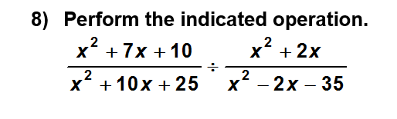
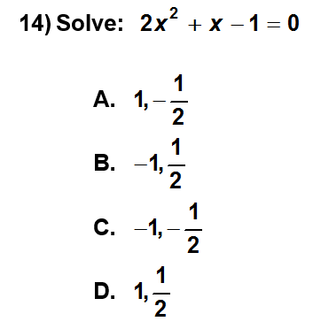
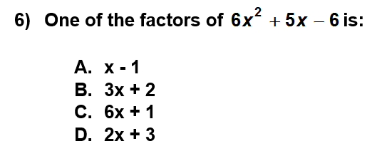
Sample Math Problems

Slide 20
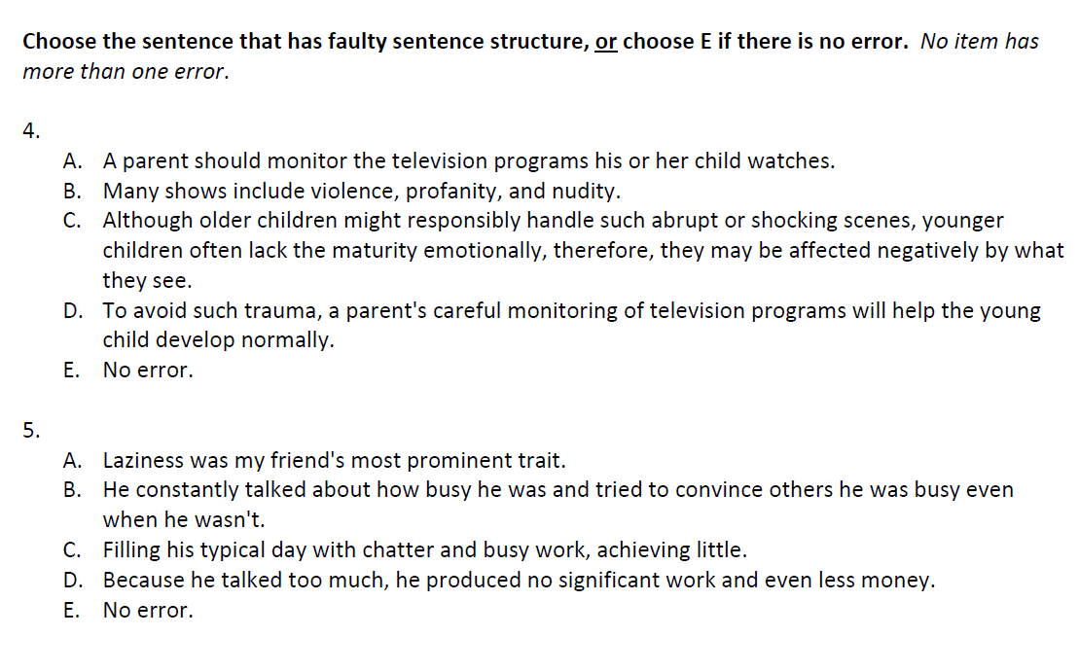
Sample Writing Problems

Slide 21
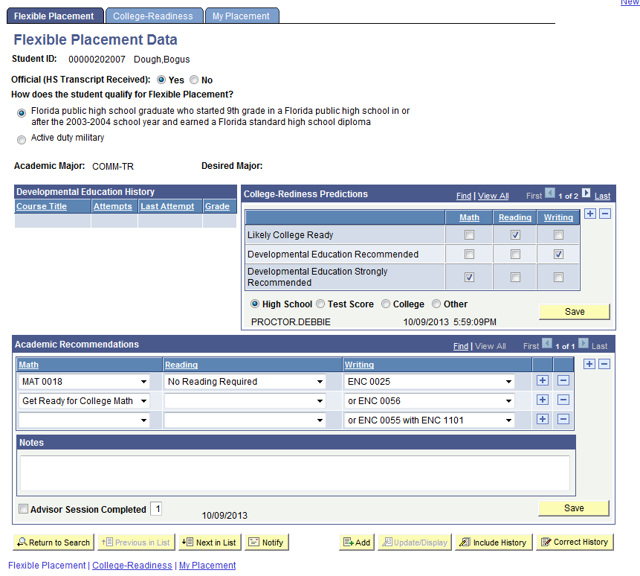
Flexible Placement Page

Slide 22
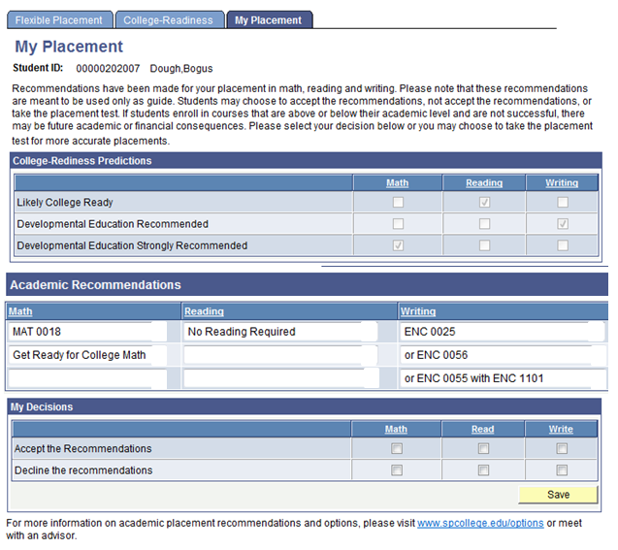
My Placement Page

Slide 23

College Readiness
  Get Ready for College: MOOCs http://www.spcollege.edu/ready/
  8,537 students have enrolled since May 2013

Slide 24
Curriculum Reforms
  MAT1033 College Algebra/Calculus STEM track
  MAT1100 Liberal Arts Math/Stats Health Sciences/Education/Public Safety track
  Co-requisite ENC1101 and ENC0055
  MAT0022 (combined MAT0018 and MAT0028)
  Friendly “pre-assessment” during registration period and on first day of class
  Adaptive Learning and Lecture methods
  Diagnostic assessments available both online and in all Composition I classes

Slide 25
Training Plan
Faculty Training
  Developmental Education Reform General Overview
  Understanding the Developmental Student in General Education
  Embedding Success Strategies in General Education Courses
  Implementing Success Strategies in General Education Courses
Advisor Training
    Developmental Education Reform General Overview (online)
    Evidence for Flexible Placement (instructor-led)
    New Advising Pages (instructor-led)
    Understanding Curriculum Choices (instructor-led)
    Developmental Education Advising Role Play (instructor-led)
http://www.youtube.com/watch?v=pyqunSGZv-w

Slide 26
Communications
  Revised Onboarding Steps for New Students
    Existing Web pages
    Letters, emails, postcards
    New Web page for Developmental Education Reform
  Inviting current and former students who qualify to see advisor for additional options

Slide 27
Prediction Model Outcomes
Courses | All FTIC Students | Likely College Ready | Dev Ed Recommend | Dev Ed Strongly Recommend
Math Recommendations
MAT 1033 and MAT 1100 | 56.6% | 60.1% (557) | 41.7% (252) | 35.6% (160)
Developmental Ed Courses | 53.0% | 40.9% (22) | 52.0% (152) | 47.9% (140)
Writing Recommendations
ENC 1101 | 69.9% | 71.1% (967) | 58.2% (189) | 50.4% (131)
Developmental Ed Courses | 72.7% | 78.0% (50) | 80.4% (56) | 62.9% (62)
Reading Recommendations
ENC 1101 | 69.9% | 73.3% (859) | 58.4% (262) | 48.8% (166)
Developmental Ed Courses | 73.1% | 88.9% (9) | 86.1% (36) | 59.3% (27)
Note: Success rates exclude Pass/Fail Grading basis courses and audits.
Source: Pulse Business Intelligence System , Campus Success Rates dashboard, Data extracted January 11, 2015

Slide 28
Success Rates
All Courses | Fall 2014 [Flex Placement Not Taking College Recommend] | Fall 2014 [Flex Placement Taking College Recommend] | Diff
Overall FTIC Flex Placement | 730 | 1,094 | ---
Overall FTIC | 55.3% | 70.5% | -15.2%
Male | 51.7% | 67.2% | -15.5%
Female | 58.2% | 72.8% | -14.6%
Black/African American | 42.6% | 55.7% | -13.1%
Hispanic/Latino | 61.7% | 75.6% | -13.9%
White | 57.8% | 72.0% | -14.2%
Black/African American Male | 37.6% | 55.7% | -18.1%
Hispanic/Latino Male | 53.4% | 73.4% | -20.0%
White Male | 55.6% | 68.1% | -12.5%
Note: Success rates exclude Pass/Fail Grading basis courses and audits. Groups defined by Custom Cohort and Dev Ed Exempt Student Group.
Source: Pulse Business Intelligence System , College Experience Outcomes dashboard, Data extracted January 11, 2015

Slide 29
Spring 2014 Results
  Developmental Education Enrollment down 23% (SSH)
Developmental Education Subject Recommended | Course | # of Dev Ed Recommended Flexible Placement Students | Success Rate of Flex Placement Students | Overall Course Success Rate
Math | MAT1033 | 235 | 23% | 47%
Writing | ENC1101 | 175 | 53% | 64%
Reading | ENC1101 | 223 | 53% | 64%
SSH= Student Semester Hours

Slide 30
Spring and Fall 2014 Comparisons Math
Prediction | Spring 2014 n=833 | Fall 2014 n=1,960
Dev Ed Strongly Recommended | 19% | 23%
Dev Ed Recommended | 42% | 35%
Likely College Ready | 39% | 43%
Enrollments | Spring 2014 (n=833) |  | Fall 2014 (n=1,960)
 | Dev Ed | College Level | Dev Ed | College Level
Dev Ed Strongly Recommended | 58% | 42% | 39% | 61%
Dev Ed Recommended | 49% | 51% | 29% | 71%
Likely College Ready | 7% | 93% | 3% | 97%
Note: College-Level is MAT1033 or MAT1100
Source: PeopleSoft query, 10/16/14

Slide 31
Spring and Fall 2014 Comparisons Writing
Prediction | Spring 2014 (n=803) | Fall 2014 (n=1,870)
Dev Ed Strongly Recommended | 12% | 13%
Dev Ed Recommended | 25% | 18%
Likely College Ready | 63% | 69%
Enrollments | Spring 2014 (n=803) |  | Fall 2014 (n=1,870)
 | Dev Ed | College-Level | Dev Ed | College-Level
Dev Ed Strongly Recommended | 38% | 62% | 17% | 83%
Dev Ed Recommended | 35% | 65% | 10% | 90%
Likely College Ready | 12% | 88% | 1% | 99%
Note: College-Level is ENC1101
Source: PeopleSoft query, 10/16/14

Slide 32
Spring and Fall 2014 Comparisons Reading
Prediction | Spring 2014 (n=713) | Fall 2014 (n=1,876)
Dev Ed Strongly Recommended | 10% | 16%
Dev Ed Recommended | 31% | 23%
Likely College Ready | 59% | 61%
Enrollments | Spring 2014 (n=713) |  | Fall 2014 (n=1,876)
 | Dev Ed | College-Level | Dev Ed | College-Level
Dev Ed Strongly Recommended | 24% | 76% | 17% | 83%
Dev Ed Recommended | 25% | 75% | 9% | 91%
Likely College Ready | 1% | 99% | 1% | 99%
Note: College-Level is ENC1101
Source: PeopleSoft query, 10/16/14

Slide 33
Top 7 College-Level Course Enrollments
Where Writing Prediction was
Dev Ed Strongly Recommended or Recommended
Course | Description | Spring 2014 Enrollment | Success Rate Flex Placement Students | Overall Success Rate | Fall 2014 Enrollment
SPC1017 | Intro to Speech | 63 | 52% | 75% | 143
SLS1101 | The College Experience | 49 | 52% | 65% | 163
REL2300 | World Religions | 31 | 51% | 76% | 123
PHI1600 | Applied Ethics | 30 | 59% | 76% | 123
PSY1012 | General Psych. | 29 | 45% | 73% | 122
HUM2270 | Humanities East – West Synthesis | 23 | 46% | 72% | 72
HUM2210 | Western Humanities | 19 | 61% | 73% | 53
Note: Not including ENC1101
Source: PeopleSoft query, 10/16/14

Slide 34
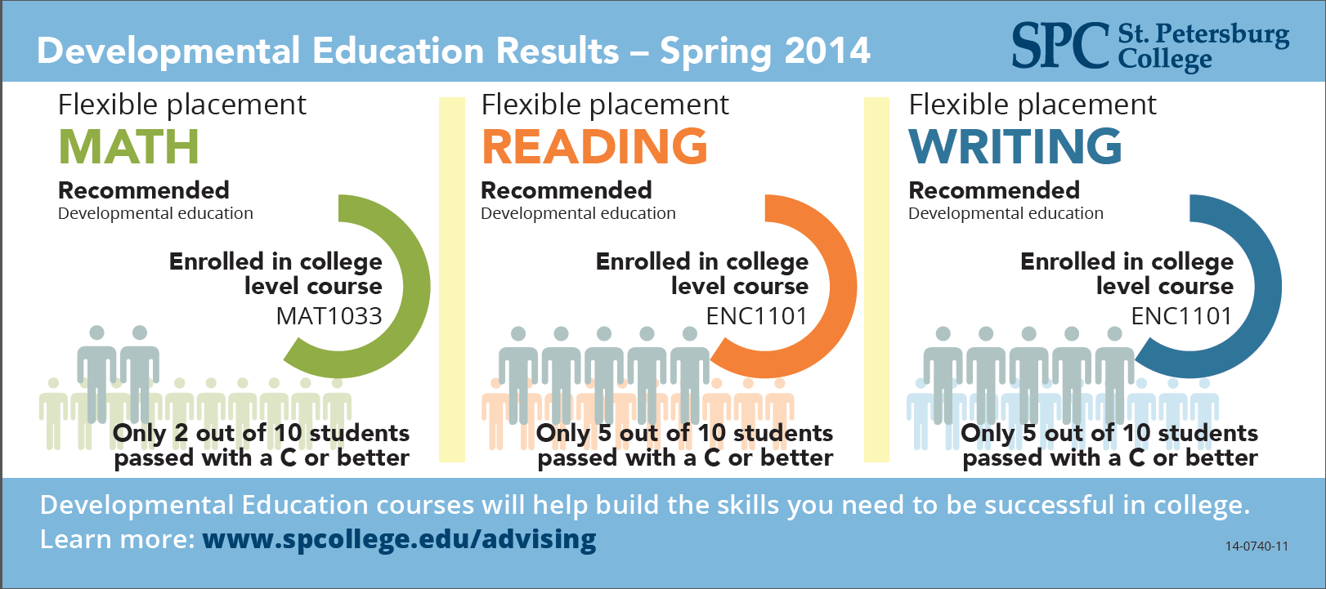
Equipping our Advisors with Data

Slide 35
Next Steps & Policy Changes
Begin Smart Start Orientation
Improve identification and communication
Implement co-requisites for Gateway Courses
Create Course Completion Milestones
Work with Pinellas County Schools (PCS) on alignment (CAG Grant)

Slide 36
Smart Start Orientation
Replaces current New Student Orientation (NSO)
Non-credit; free to students
Facilitated by advising staff; key contact
Required of all new AA and AS degree-seeking students

Slide 37
Smart Start Orientation
Blended format: 1 hr., 15 min. in class and…
Online version available
Class size of 25; small group work
Emphasis on hands on; interactive; mentoring
Graded S/U

Slide 38
Smart Start Orientation
Prior to the beginning of class: “Getting Started”
Week 1: “Student Resources”
Week 2: “Navigating SPC”
(Systems, Processes and Where/How to Access Them)
Week 3: “Career Planning”
Week 4: “Academic Planning”

Slide 39
Questions?

